Slide 1
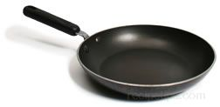
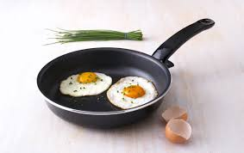
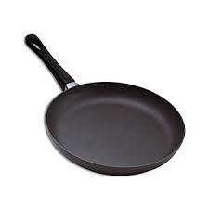
DESIGN FOR MANUFACTURING AND ASSEMBLY
MPD18I003
FRYING PAN
Frying pan is a flat-bottomed pan with shallow sides which are curved at the ends. They are made of various materials, such as copper, cast-iron and aluminum, and some have a non-stick coating applied, which makes for easy cleanup. It is used for frying food over medium to high heat hence it should be thick enough to conduct heat evenly.
Components
Handle
Flat-bottomed body
Joints(riveted)
Steel connector

Slide 2
PROBLEM DEFINITION
CUSTOMER REQUIREMENTS
OBJECTIVE
To reduce failure of riveted joints connecting body and handle in a frying pan.
To increase life of coating.
CONSTRAINTS
Health should be given priority.
Cost should be minimum.
FUNCTION
Cook food.
Portability.
SPECIFICATIONS
Dimensions should be considered.
Sturdy handle to hold the pan.
Light weight
Long life
Environment friendly (healthy)

Slide 3
CONCEPT DESIGN
Analyze objectives, function and constraints to get different concepts, select best concept
EMBODIMENT DESIGN(tentative)
DETAILED DESIGN(tentative)
DESIGN COMMUNICATION
Design concepts
Enhancements in joints in the existing design are considered.
Enhancing the coating in the existing design.
Structural optimization of handle of product using better material.
Analysis of the chosen design concept and providing shape to product.
Test and evaluate the design concept.
Refining and optimizing the design concept.
Assign and specify the design details.
Documentation of final design.

Slide 4
ANALYSIS OF MATERIAL PERFORMANCE REQUIREMENTS
HANDLE
FLAT BOTTOMED BODY
RIVET JOINT
STEEL CONNECTOR
Strength
Coefficient of thermal expansion
Cost
Roughness
Ease of shaping
Young’s modulus
Cost
Coefficient of thermal expansion
Density
Young’s modulus
Material
Coefficient of thermal expansion.
Strength
Cost
Young’s modulus
Density
Thermal conductivity
Coefficient of thermal expansion
Cost
Strength
Density
Young’s modulus

Slide 5
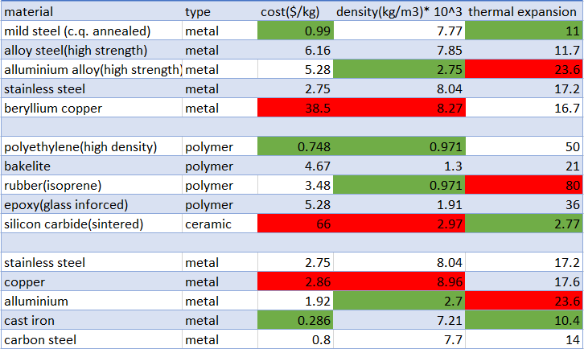
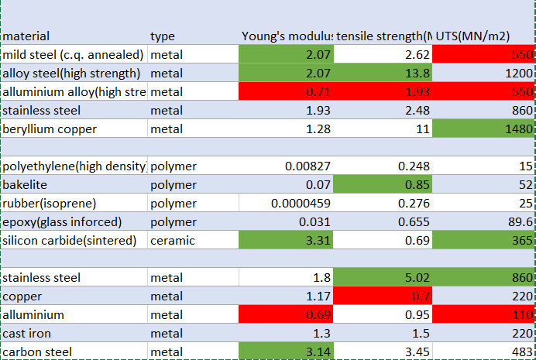
INITIAL SCREENING METHODS
Here, we consider least required and most required material performance requirement for materials.
Least required
Most required
Here three parts are considered, namely connector, handle and body respectively as shown above. Cost is one the most important factors, hence beryllium, silicon carbide and copper are not taken.

Slide 6
DIGITAL LOGIC METHOD
The properties chosen are Strength, density, young’s modulus, UTS and thermal expansion.( connector)
*The number of positive decisions is equal to 5(5-1)/2=10
Material P R | 1 | 2 | 3 | 4 | 5 | 6 | 7 | 8 | 9 | 10 | (+) | alpha
Density | 0 | 0 | 1 | 0 |  |  |  |  |  |  | 1 | 0.1
Strength | 1 |  |  |  | 1 | 1 | 1 |  |  |  | 4 | 0.4
UTS |  | 1 |  |  |  | 0 | 1 | 0 |  |  | 2 | 0.2
Thermal expansion |  |  | 0 |  |  |  | 0 | 0 | 1 |  | 1 | 0.1
Young’s modulus |  |  |  | 1 |  |  |  | 0 | 1 | 0 | 2 | 0.2
 |  |  |  |  |  |  |  |  |  |  | 10 | 1
Using digital logic method, we find alpha and beta is found from varying materials
material | type | Relative cost | Cost/strength*100 | Performance index | Rank
mild steel (c.q. annealed) | Metal | 1 | 2.9 | 50.297 | 1
alloy steel (high strength) | Metal | 6.222 | 3.53 | 92.904 | 2
aluminium alloy (high strength) | Metal | 5.333 | 7.59 | 36.221 | 3
stainless steel | Metal | 2.777 | 9 | 43.371 | 4
From the table, we see that material performance index is high for alloy steel but relatively cost is more. However, mild steel is much better choice hence the ranking.
Similarly, we get materials for handle and body as bakelite and aluminium alloy respectively.

Slide 7
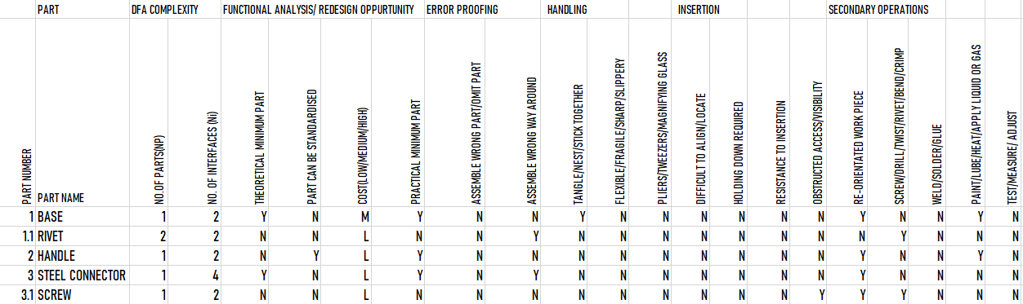
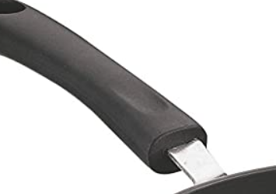
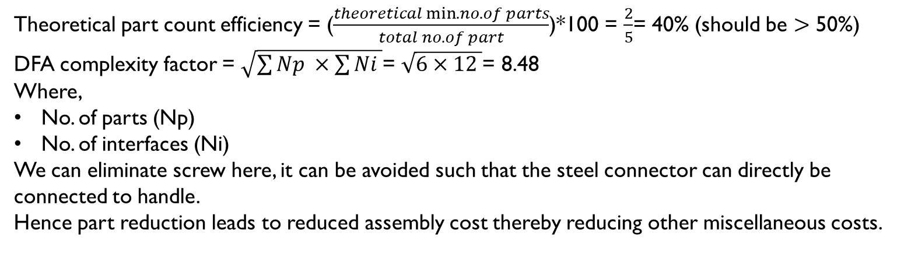
DESIGN FOR ASSEMBLY
Theoretical part count efficiency = ($\frac{theoretical min. no. of parts}{total no. of part}$)*100 = $\frac{2}{5}$= 40% (should be $>$ 50%)
DFA complexity factor = $\sqrt{\sum{Np ×\sum{Ni }}}$= $\sqrt{6×12 }$= 8.48
Where,
No. of parts (Np)
No. of interfaces (Ni)
We can eliminate screw here, it can be avoided such that the steel connector can directly be connected to handle.
Hence part reduction leads to reduced assembly cost thereby reducing other miscellaneous costs.

Slide 8
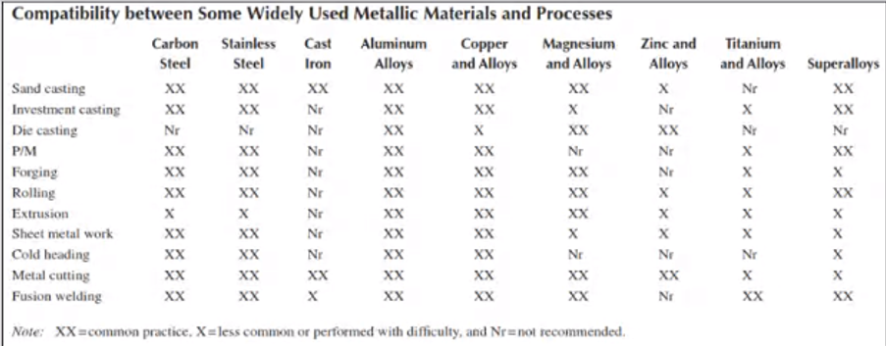
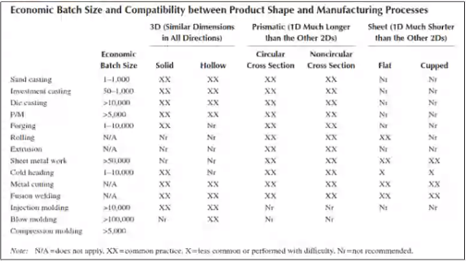
Selection of manufacturing processes
We can see that aluminum alloys are commonly processed by die casting. From both figures in terms of batch size, shape and material chosen, we can conclude that die casting can be preferred as primary process of making base of the product.
Steel connector – primary process is sheet metalworking. This is obtained by comparing process with material, batch size and shape.
Handle – primary process is injection molding.
Secondary processes include finishing jobs and inspection.

Slide 9
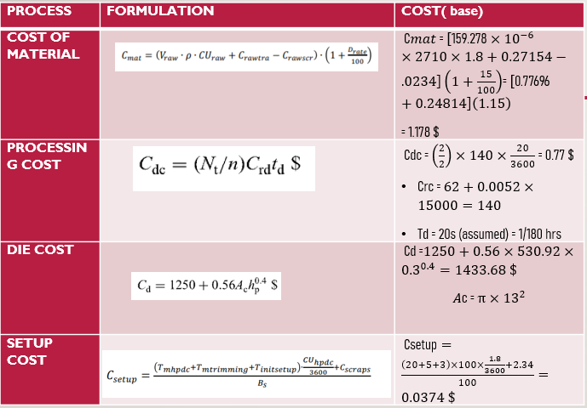
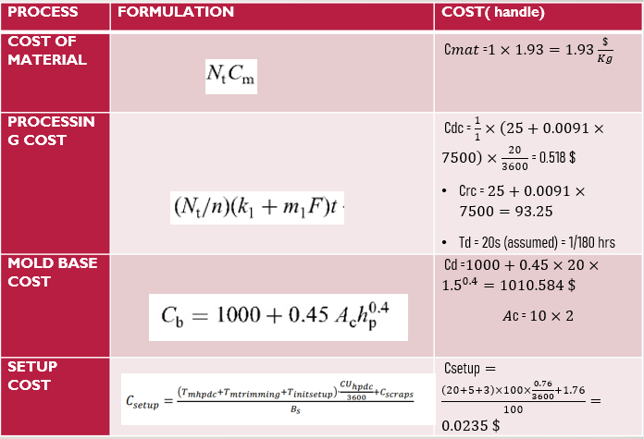
COST ESTIMATION
Total cost for base body = $1.178+0.77+0.0374=1.9854 \$$
Total cost for handle = 0.518$+0.0235+1.93=2.4715 \$$

Slide 10




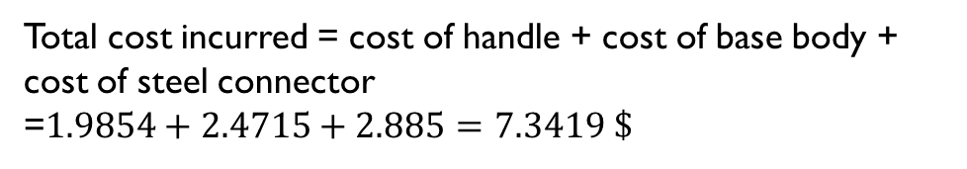
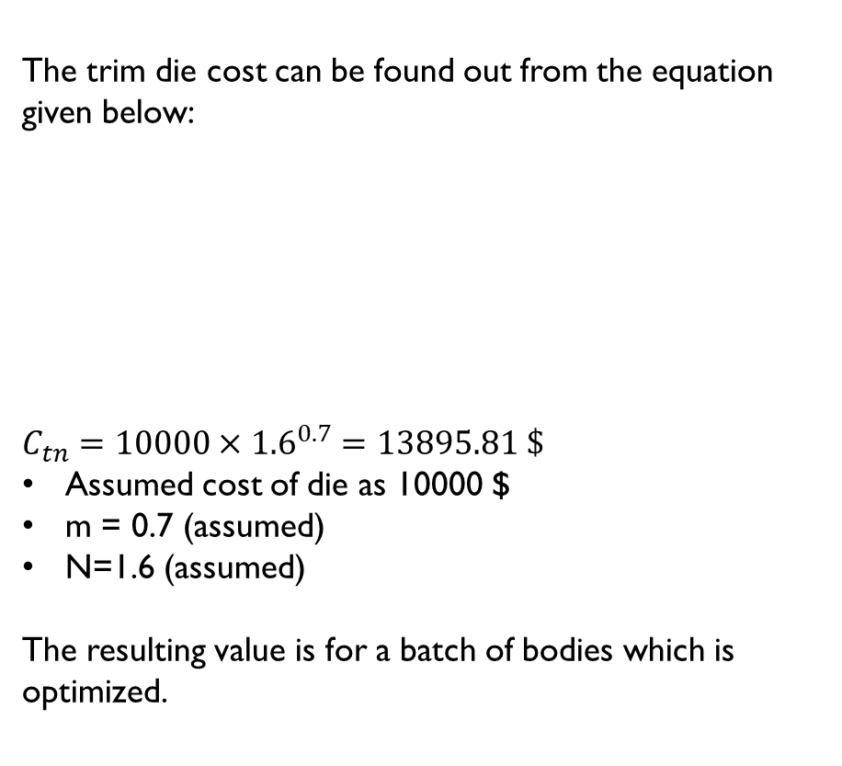
OPTIMIZATION OF TRIM DIE COST
PROCESS | FORMULATION | COST(Steel connector)
Cost of individual die set | Where, C_{ds}=die set purchase cost, $ A_{u}= usable area, cm² | Usable area=3*10 = 30 cm² Dimension of rod: C_{ds}=120+0.36*30 = 130.8 $
Bending operation | Where, L_{b}= Total length of bend lines, cm N_{b}= Number of different bends to be formed in the die M_{pn}= Manufacturing time (hours) Then Multiply by cost per hour (assume) | M_{pn} *Hourly cost=(0.68*2.5)+(5.8*1)*0.0012 = 1.70696 $
Raw Material cost | Volume x Density x Material cost per kg Considering high steel strength | =0.000006*0.25*7.9 =0.00001185 $
Cycle time per one piece |  | =3.8+0.11(10) =4.9 sec
Total manufacturing cost | Raw material cost+ {(Hourly Cost)*(Cycle time per one piece) /(Efficiency)}+ Tooling costs | =0.00001185+ {(20*4.86)/82.5}+1.70696 =2.885 $
The trim die cost can be found out from the equation given below:
$$C_{tn}=10000×{1.6}^{0.7}=13895.81 \$$$
Assumed cost of die as 10000 $
m = 0.7 (assumed)
N=1.6 (assumed)
The resulting value is for a batch of bodies which is optimized.
Total cost incurred = cost of handle + cost of base body + cost of steel connector
=$1.9854+2.4715+2.885=7.3419 \$$

